Slide 1
Fundamentals of Data Representation Lesson 2
Hexadecimal

Slide 2
Recap
So if binary is a base 2 number system that has the numbers 0 and 1.
And denary (base 10) uses the numbers 0 , 1, 2, 3, 4, 5, 6, 7, 8, 9.
How can we display numbers bigger than 9? For example, 10, 11, 12, 13 etc?
We’ll come back to this…

Slide 3

Learning Objectives
Understand why hexadecimal number representation is often used and know how to convert between binary, denary and hexadecimal.
Success Criteria
Will be able to state what hexadecimal is and why it’s used, you will be able to convert simple decimal numbers to hexadecimal.
Will be able to convert easily between binary, denary and hexadecimal.
Will create a spreadsheet model that automatically converts between binary, denary and hexadecimal.

Slide 4
Which one is easier to remember?
01011011
OR
5B
Humans are not very good at remembering long strings of numbers.
To make it easier for us, we can represent every group of 4 bits (a nibble) with a single digit.

Slide 5
Introducing Hexadecimal
The smallest value you can have with 4 bits is 0000. The largest value is 1111.
This means that we need to represent the denary values 0 to 15 with a single digit. The trouble is, we only have numerical digits 0 to 9!
To get around this problem we use letters to fill the gap until we get to 16.
This is called Base 16 in Maths, or hexadecimal in Computing. We abbreviate this to hex.

Slide 6
Hexadecimal
Hexadecimal is a base 16 number system.
Denary | Hexadecimal
0 | 0
1 | 1
2 | 2
3 | 3
4 | 4
5 | 5
6 | 6
7 | 7
8 | 8
9 | 9
Denary | Hexadecimal
10 | A
11 | B
12 | C
13 | D
14 | E
15 | F

Slide 7
Converting from Hexadecimal
F = 15
Hexadecimal Number FF to denary
 | 4096 | 256 | 16 | 1
Hexadecimal |  |  | F | F
+
(16 * 15) = 240
(1 * 15) = 15
Denary = 255

Slide 8
Converting from Hexadecimal
Hexadecimal Number 8D to denary
D = 13
 | 4096 | 256 | 16 | 1
Hexadecimal |  |  | 8 | D
+
(16 * 8) = 128
(1 * 13) = 13
Denary = 141

Slide 9

Converting from Hexadecimal
E = 14
On whiteboards convert EE to denary
 | 4096 | 256 | 16 | 1
Hexadecimal |  |  | E | E
+
(16 * 14) = 224
(1 * 14) = 14
Denary = 238

Slide 10
Converting from Hexadecimal
A = 10
C = 12
On whiteboards convert AC to denary
 | 4096 | 256 | 16 | 1
Hexadecimal |  |  | A | C
+
(16 * 10) = 160
(1 * 12) = 12
Denary = 172

Slide 11
Why hexadecimal?
Hex numbers are shorter/more memorable than equivalent binary numbers..
... and can easily be converted to and from binary...
... as each hexadecimal digit corresponds to 4 binary digits

Slide 12
Hexadecimal Conversions
Complete the conversions on the sheet (and stick this in your books!)

Slide 13
Binary to Hex
Really you will only ever see 8-bit binary numbers at GCSE level, which can be represented as two hex digits.
The first hex digit represents groups of 16, the second hex digit represents the units left over.
denary = = in hex
01011100
5C
92
5
(groups of 16)
12
units
(replaced by C)

Slide 14
Denary to Hex
To convert 182 in denary into hex the first step is to work out how many groups of 16 there are in 182.
Secondly work out how many units are left over.
182 / 16 = 11 remainder 6
11 is B in hex. 6 is just 6! So 182 denary = B6 hex
Alternatively, you can convert the denary to binary first and then convert the binary to hex, as above.

Slide 15
Extension – Challenge!
Can you create a spreadsheet that will automatically work out the denary number from the hexadecimal number you type in (or vice versa?), or binary to hexadecimal?
Validate it so you can only enter a 0 or 1

Slide 16
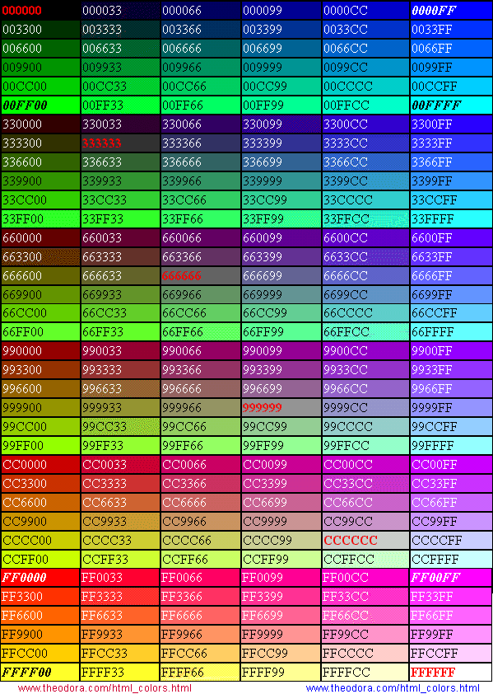
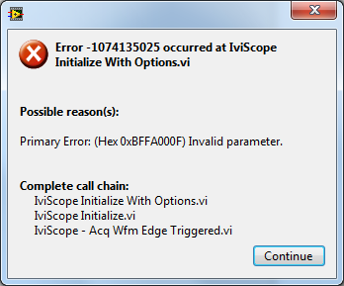
USES OF HEXADECIMAL
Used in error messages
http://bit.ly/1lW3MGI
Representation of colours in images and HTML
Challenge! – what other uses of hexadecimal in computing can you find?

Slide 17
Review
So if binary is a base 2 number system that has the numbers 0 and 1.
And denary (base 10) uses the numbers 0 , 1, 2, 3, 4, 5, 6, 7, 8, 9.
How can we display numbers bigger than 9? For example, 10, 11, 12, 13 etc?
Can you explain this?

